Slide 1
Chapter 13b
Exception Handling

Slide 2
Motivation
When a program runs into a runtime error, the program terminates abnormally and displays an “unfriendly” error message on the console.
How can you handle the runtime error so that the program can continue to run or terminate gracefully? This is the subject we will introduce in this chapter.

Slide 3
Objectives
To handle exceptions using the try/except/finally clauses
To access exception object in the handler
To understand Python’s exception class heirarchy
How you can raise your own exception (instead of just responding to exceptions raised by other python code).

Slide 4


Unhandled Exceptions
When you run the program below, what happens if the user enters something other than a number? Because the program cannot convert the input to an integer, it raises an exception, which causes the program to terminate abnormally and then it prints the exception error message to the console.

Slide 5
Handled Exceptions
To prevent your program from terminating abnormally, put the “dangerous” code in a “try” block and follow that with an “except” block as shown below. If an exception is raised in the try block, control goes to the except block. This is how we prevent the program from terminating abnormally and displaying an error message on the console.

Slide 6
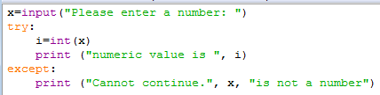


Handled Exceptions
Here's how it runs (two different times, once with "good" data, once with "bad").

Slide 7
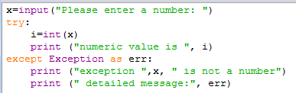

Accessing the Exception Object
You can access the exception object in the except clause, if you want to get more information about what caused the problem. Then it’s your choice to display it the user or not.

Slide 8
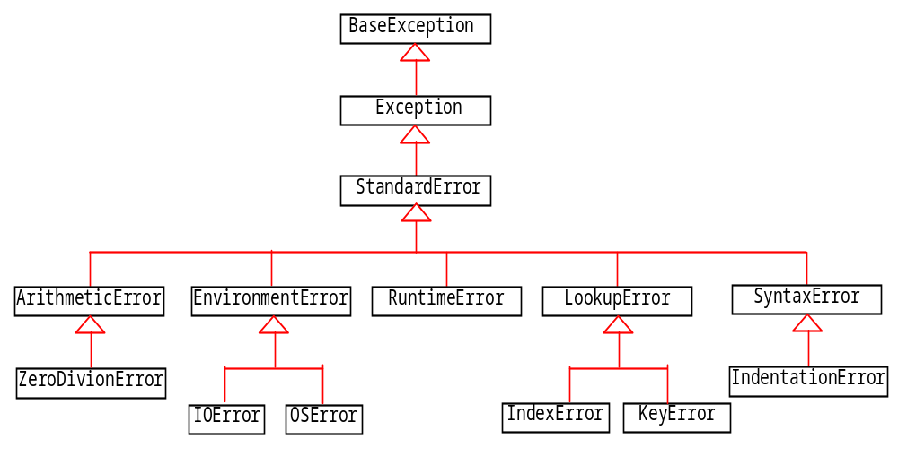
Python Exception Class Heirarchy

Slide 9
The try ... except Clause
try:
<body>
except <ExceptionType1>:
<handler1>
...
except <ExceptionTypeN>:
<handlerN>
except:
<handlerExcept>
else:
<process_else>
finally:
<process_finally>
One try block can have multiple except blocks. Put the most specific type of exception first, and the most general last (based on the exception heirarchy just shown). Only one except block will be executed. If no except blocks are executed, the else block will run. Then, the finally block will always run. See code example.
TestException
Run

Slide 10
Raising Exceptions
You learned how to write the code to handle exceptions in the preceding section. Where does an exception come from? How is an exception created? Exceptions are objects and objects are created from classes. An exception is raised from a function. When a function detects an error, it can create an object of an appropriate exception class and raise the object, using the following syntax:
raise ExceptionClass("Something is wrong")
RaiseException
Run

